Slide 1
CLASS-IX
SUB- MATHEMATICS
TOPIC: TRIANGLES

Slide 2
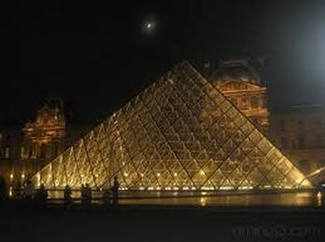
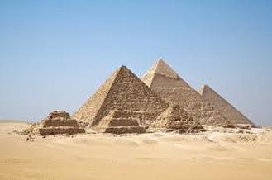
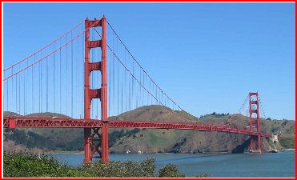
Introduction:
If there is a single most important shape in engineering, it is the triangle. Unlike a rectangle, a triangle cannot be deformed without changing the length of one of its sides or breaking one of its joints. In fact, one of the simplest ways to strengthen a rectangle is to add supports that form triangles at the rectangle's corners or across its diagonal length. A single support between two diagonal corners greatly strengthens a rectangle by turning it into two triangles. Triangulation of material, adds strength by eliminating lateral movement.
Triangles are used to make rafters in buildings and curved domes. Some bridges have triangular structures, and the Egyptians made triangular-shaped pyramids. The shapes help surveyors use triangulation to determine the distance of a specific point from two other points of a known distance apart. Triangulation may be used to measure distances around corners and when digging tunnels, and carpenters use a right-angled triangle to take measurements

Slide 3
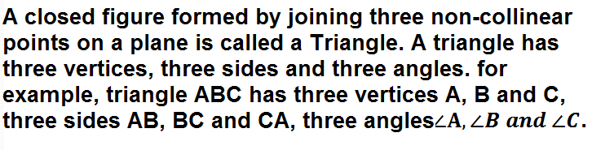
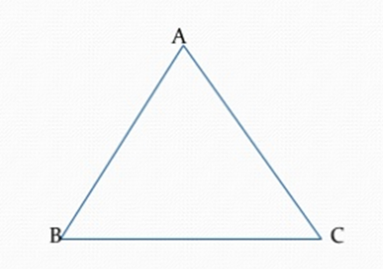
What is a Triangle???

Slide 4
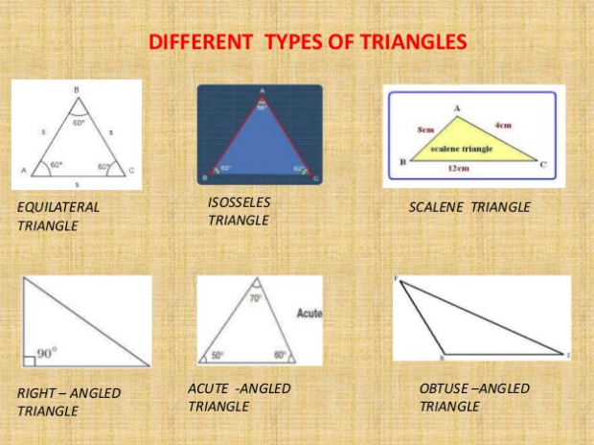

Slide 5
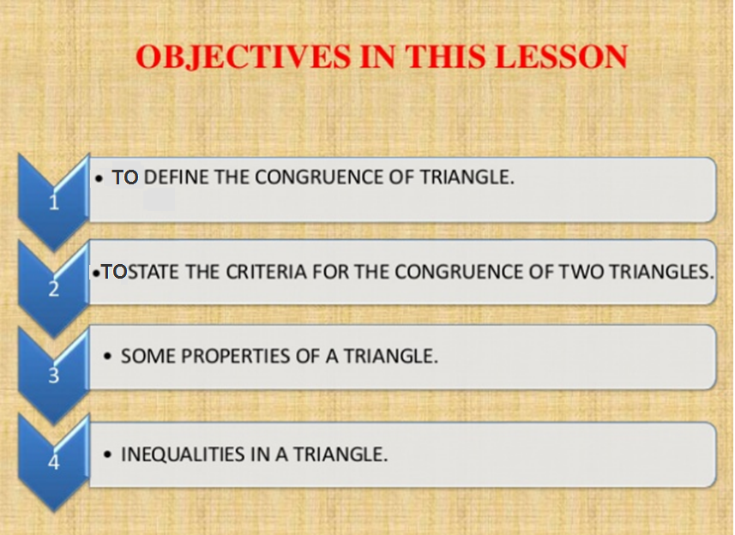
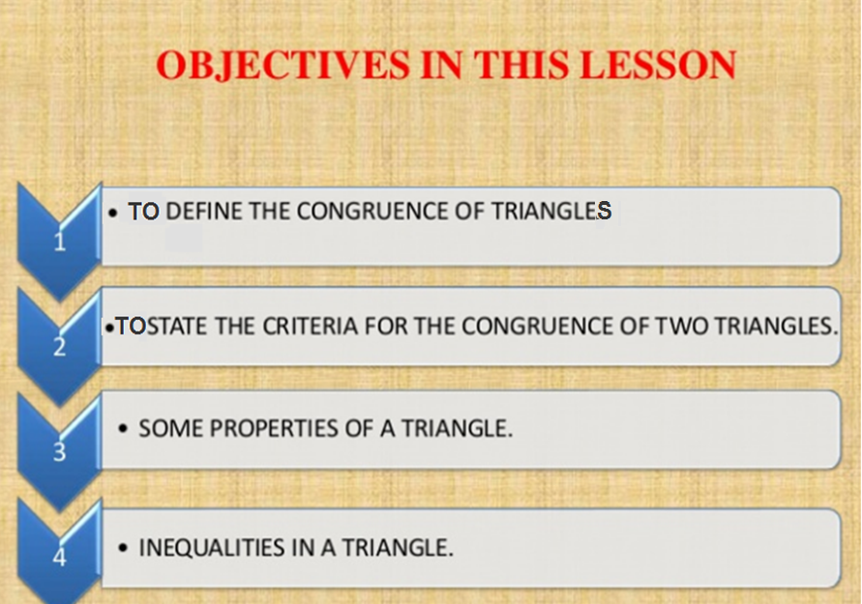

Slide 6


The Idea of Congruence of two
Objects:
Two figures with exactly the same size and shape.
F
B
A
C
E
D
Congruency in real life(hyperlink)

Slide 7
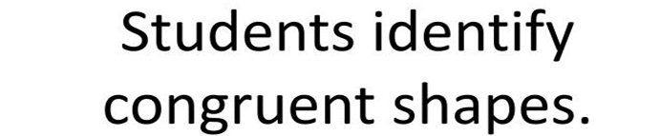
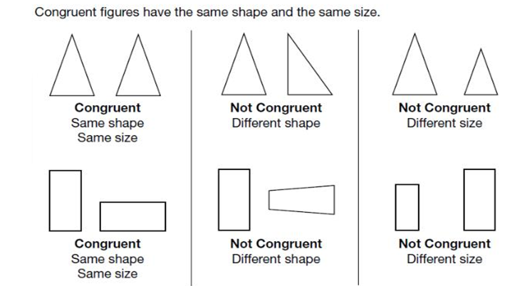

Slide 8
How much do you
need to know. . .
. . . about two triangles
to prove that they
are congruent?

Slide 9
Corresponding Parts
If all six pairs of corresponding parts (sides and angles) are congruent, then the triangles are congruent.
AB ≅ DE
BC ≅ EF
AC ≅ DF
∠ A ≅ ∠ D
∠ B ≅ ∠ E
∠ C ≅ ∠ F
B
A
C
ΔABC ≅ Δ DEF
E
F
D

Slide 10
Do you need all six ?
NO !
SSS
SAS
ASA
AAS

Slide 11
Side-Side-Side (SSS)
B
E
F
A
C
D
AB ≅ DE
BC ≅ EF
AC ≅ DF
ΔABC ≅ Δ DEF

Slide 12
Side-Angle-Side (SAS)
B
E
F
A
C
D
AB ≅ DE
∠A ≅ ∠ D
AC ≅ DF
ΔABC ≅ Δ DEF
included
angle

Slide 13
Angle-Side-Angle (ASA)
B
E
F
A
C
D
∠A ≅ ∠ D
AB ≅ DE
∠ B ≅ ∠ E
ΔABC ≅ Δ DEF
included
side

Slide 14
Angle-Angle-Side (AAS)
B
E
F
A
C
D
∠A ≅ ∠ D
∠ B ≅ ∠ E
BC ≅ EF
ΔABC ≅ Δ DEF
Non-included
side

Slide 15
Warning: No SSA Postulate
There is no such thing as an SSA postulate!
B
E
F
A
C
D
NOT CONGRUENT

Slide 16
Warning: No AAA Postulate
There is no such thing as an AAA postulate!
B
E
A
C
F
D
NOT CONGRUENT

Slide 17
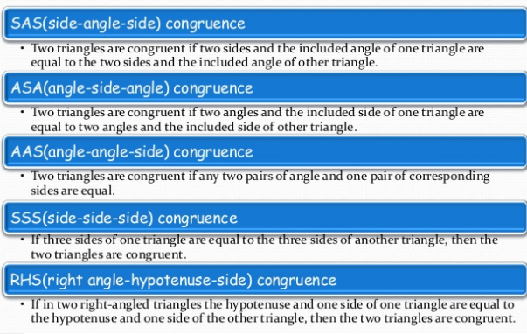
The Congruence Criateria:

Slide 18
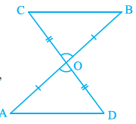






Axiom:7.1 (SAS congruence rule): Two triangles are congruent if two sides and the included angle of one triangle are equal to the sides and included angle of the other triangle.
Let us Try this:
Why?
(Because they are vertically opposite angles)
So,
Why?
Why?
(CPCT)
Why?
(as one pair of alternate interior angles are equal)

Slide 19
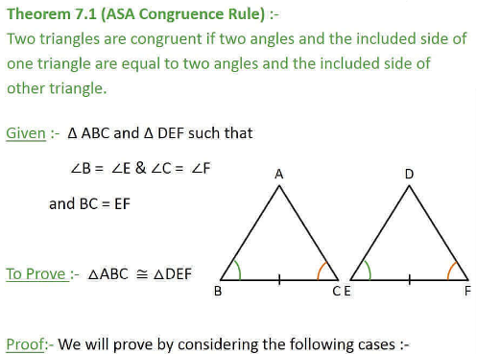

Slide 20
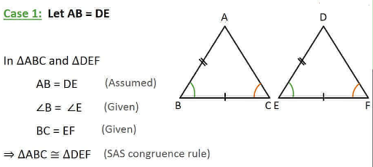

Slide 21
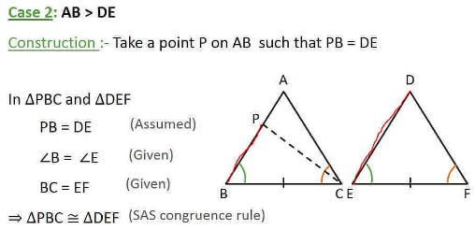
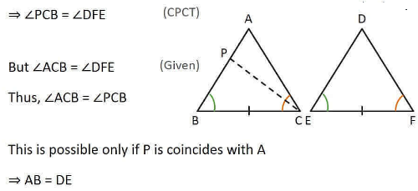


Slide 22
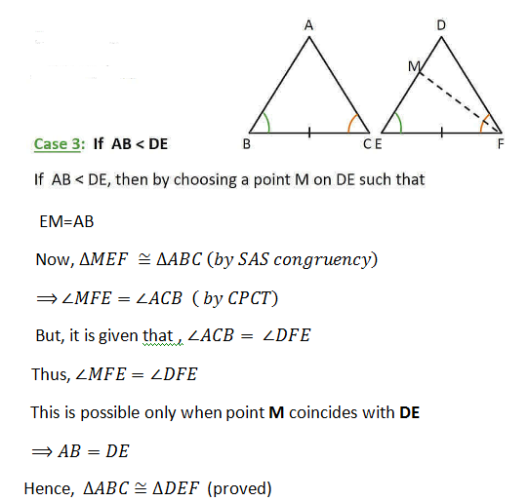

Slide 23



Now, try this:
Why?
(since they are alternate interior angle)
(ii)AC=CA
Why?
(As it is the common arm)
Hence, By ASA congruence condition,

Slide 24
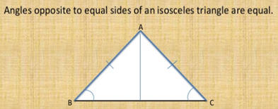

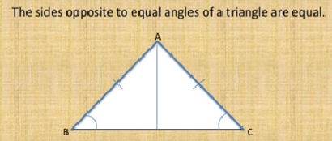
Properties of a triangle
Isosceles triangle property
Converse of isosceles triangle property: hyperlink

Slide 25
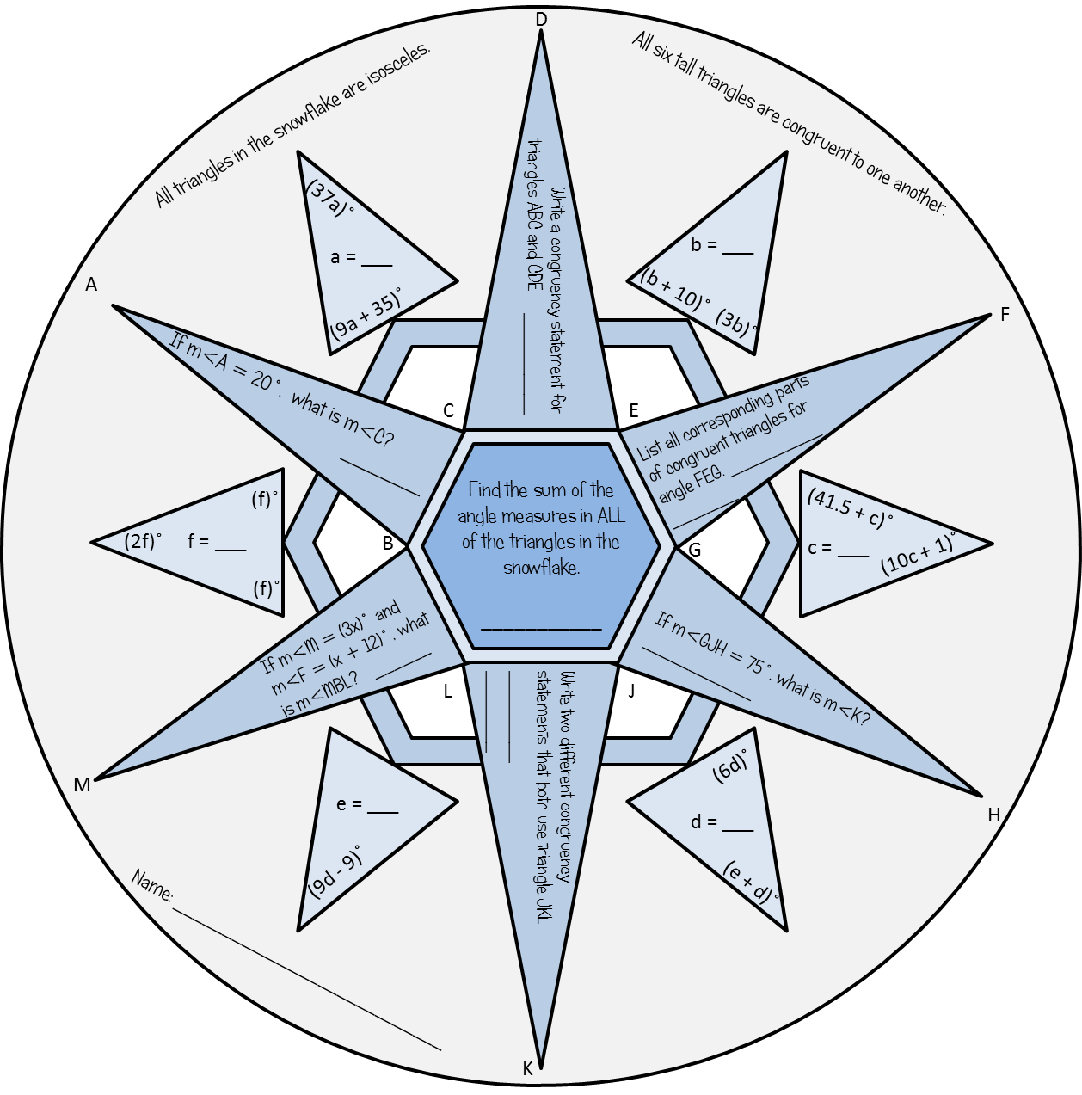
Let us do this snowflake activity

Slide 26
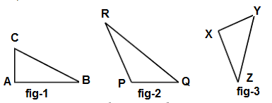
Inequalities in a Triangle
Let us Construct 3 different scalene triangle (that is a triangle in which all sides are of different lengths).
Measure the lengths of the sides.
Now, measure the angles. What do you observe?
In Δ ABC of Fig -1, BC is the longest side and AC is the shortest side.
Also, ∠ A is the largest and ∠ B is the smallest.
Repeat this activity for other two triangles.
We arrive at a very important result of inequalities in a triangle.
If two sides of a triangle are unequal, the angle opposite to the longer side is larger (or greater).

Slide 27
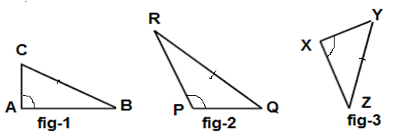
Now let us Construct 3 different triangles in which all angles are of different measure.
Measure the angles of these triangles.
Now, measure the length of sides. What do you observe?
In Δ ABC of Fig -1, ∠ A is the largest and BC is the longest side and side BC is the side opposite to ∠ A
Repeat this activity for other two triangles.
We arrive at a very important result of another inequality in a triangle.
In any triangle, the side opposite to the larger (greater) angle is longer.

Slide 28
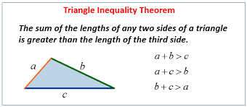
Let us perform an activity to prove these inequalities. (Hyperlink)

Slide 29
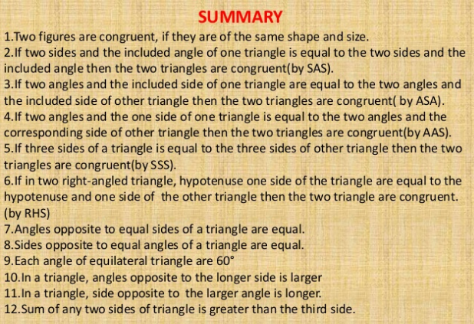

Slide 30


